Slide 1





Dedupe: Eliminating duplication in Cloud Storage with Machine Learning
Co-founders
Ashish Veeramachaneni
Poojitha Jakkampudi
Chandan Chowdary Ghanta
Jagathi Sai Guthikonda
Harika Potluri

Slide 2
Enterprises
Schools & Universities
All Cloud Users
TARGET MARKET AND VALUE PROPOSITIONS:
Simplified Back-up
Cost Efficient
Data Can Be Retrieved With-out Any Duplicate Files

Slide 3
KEY FEATURES:
Encryption Key Will Be Required To Upload The Files .
With-out The Key No One Will Be Able To Open The File.
Data Is Deduplicated At The Source(back-up Client)
Back-up Client Sends Only New, Unique Segments Across The Network.
Reduced Storage Capacity And Network Band-width Requirements.

Slide 4
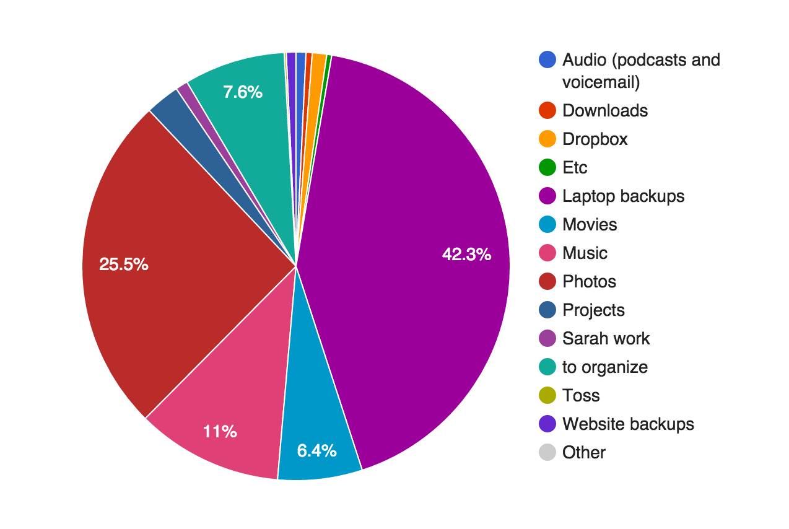
CAPABILITIES:
Storage Optimization
Cost effective
Integrity of Data
Confidentiality
Eliminates Redundant Data

Slide 5
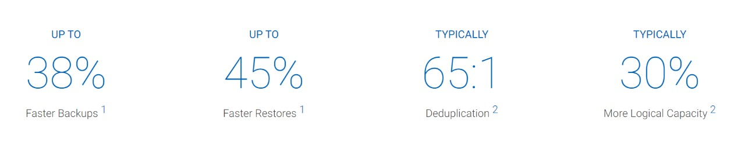
JUSTIFICATION:
Enterprises of all sizes rely on backup and recovery with deduplication for fast, reliable, and cost-effective backup and recovery.
Any user can store personal data in to cloud without storing the same dataset multiple times.

Slide 6
IMPLEMENTATION AND CONCLUSION:
Registration
No
Login
File Upload (or) Download
Download
Upload
Check
Authentication
Duplication
No
Uploaded in Cloud
Yes
Yes
Download File
Access Denied

Slide 7
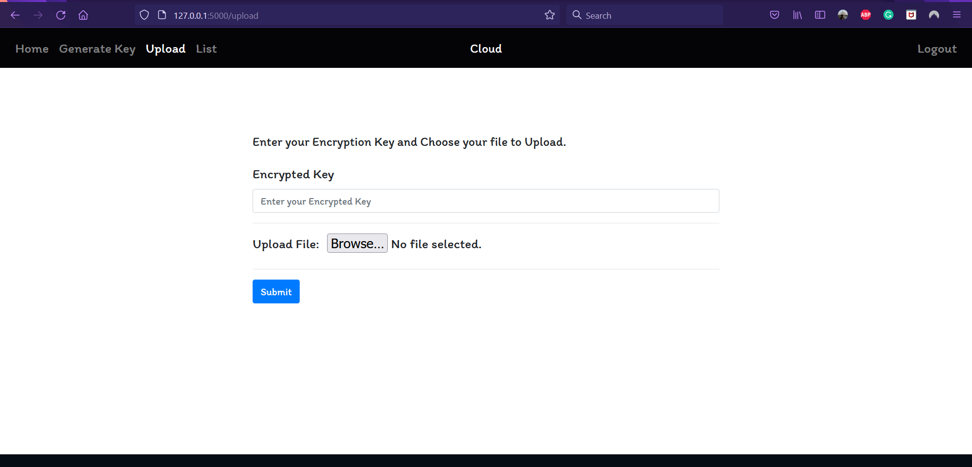
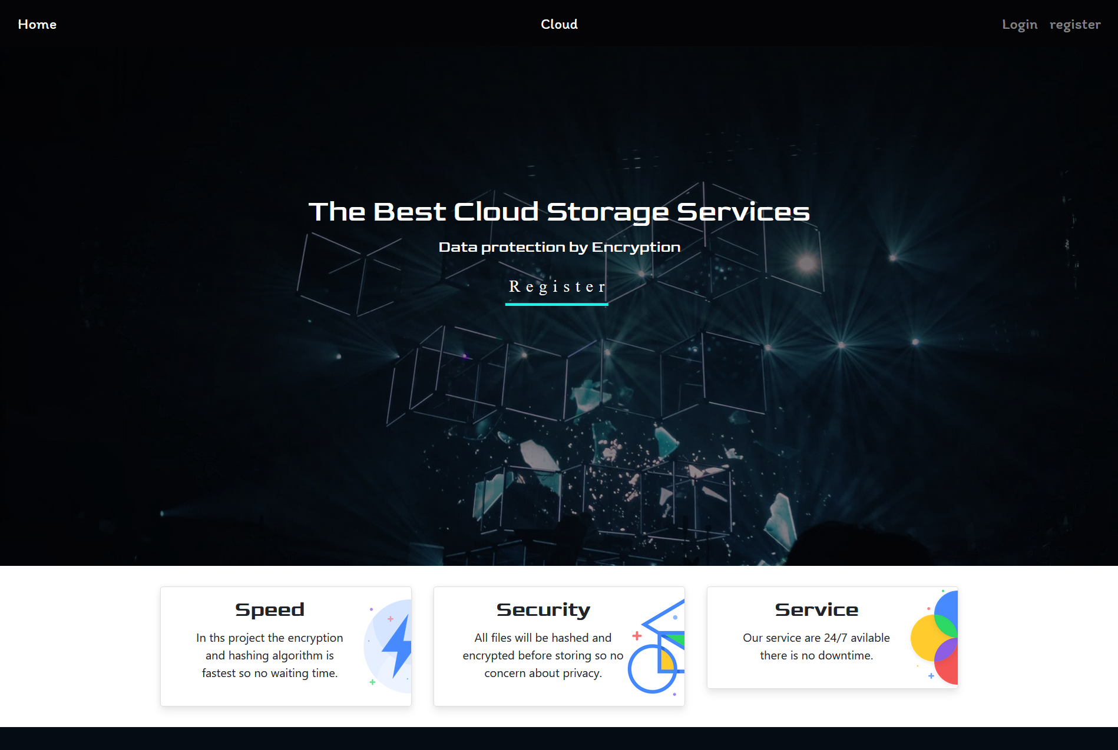
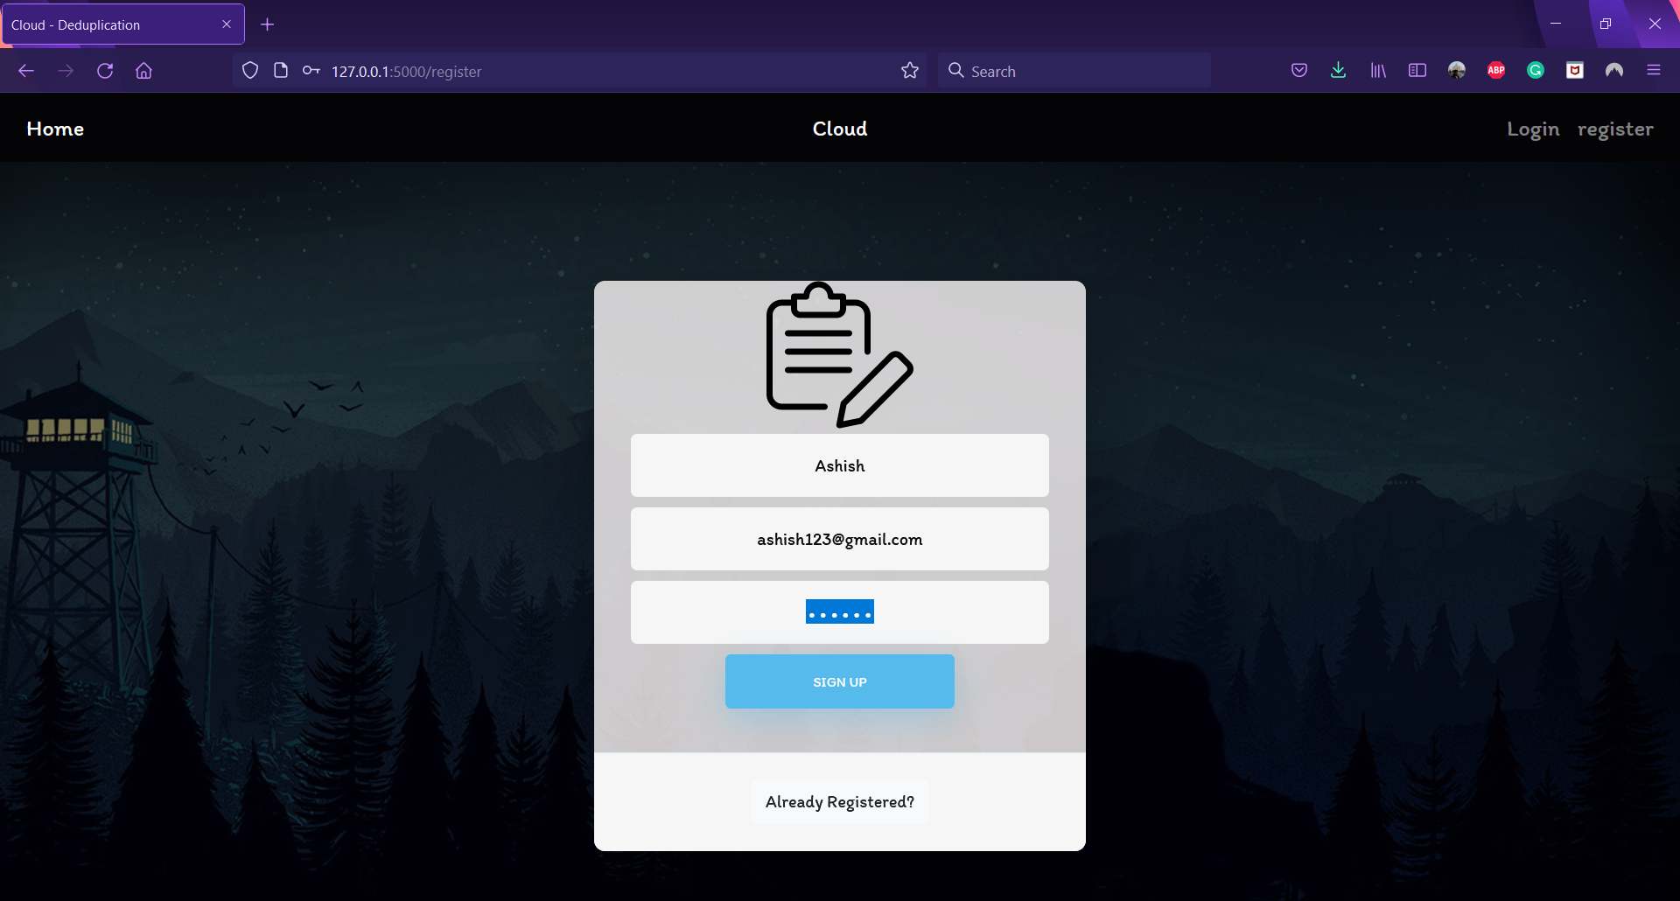
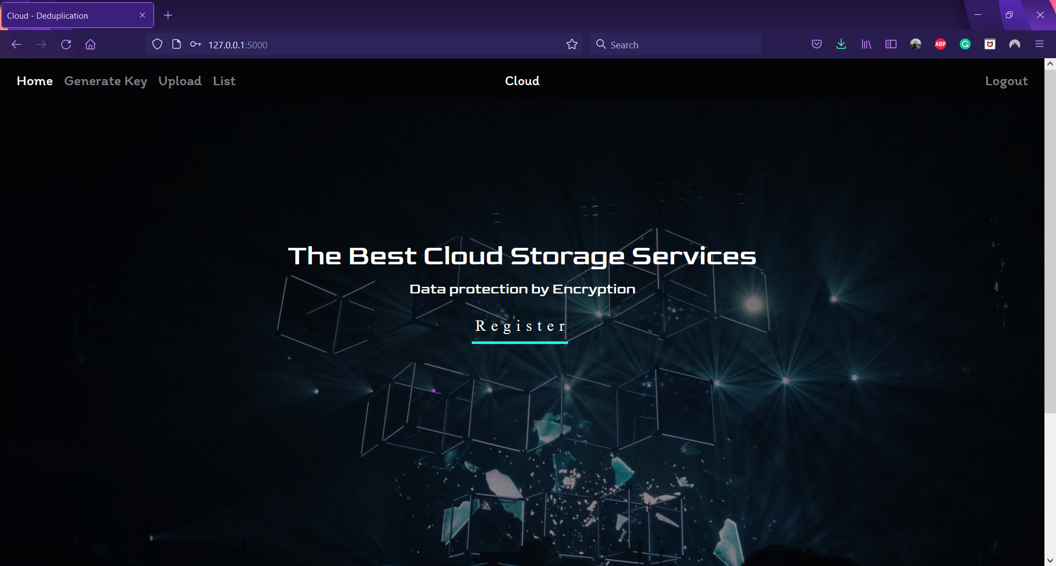
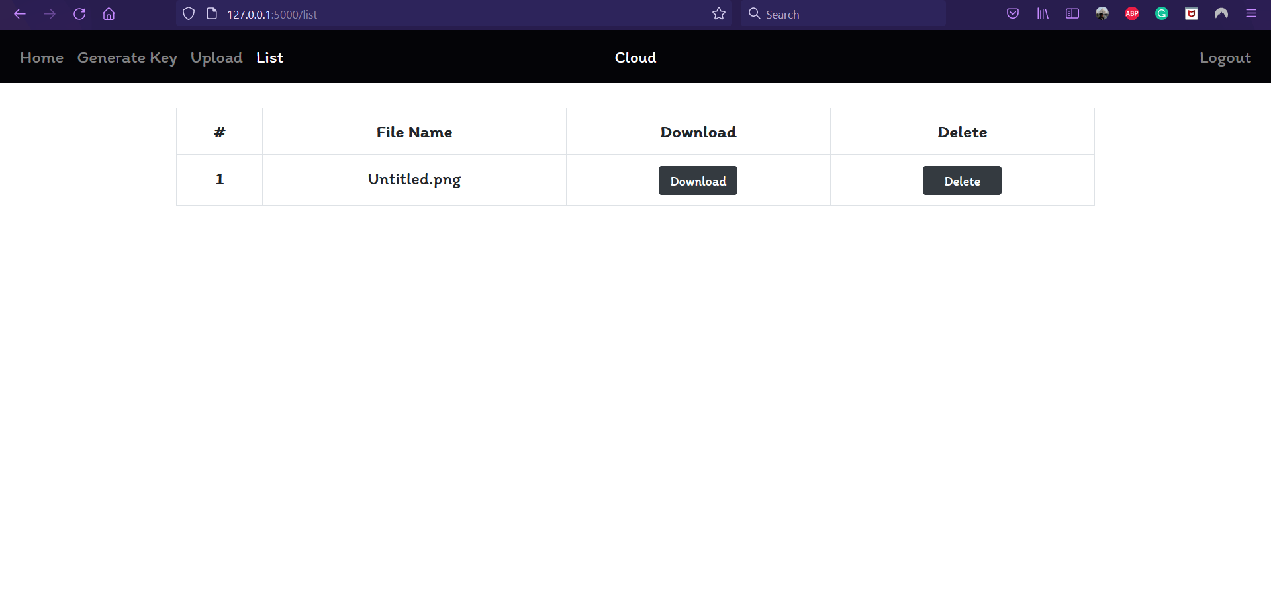
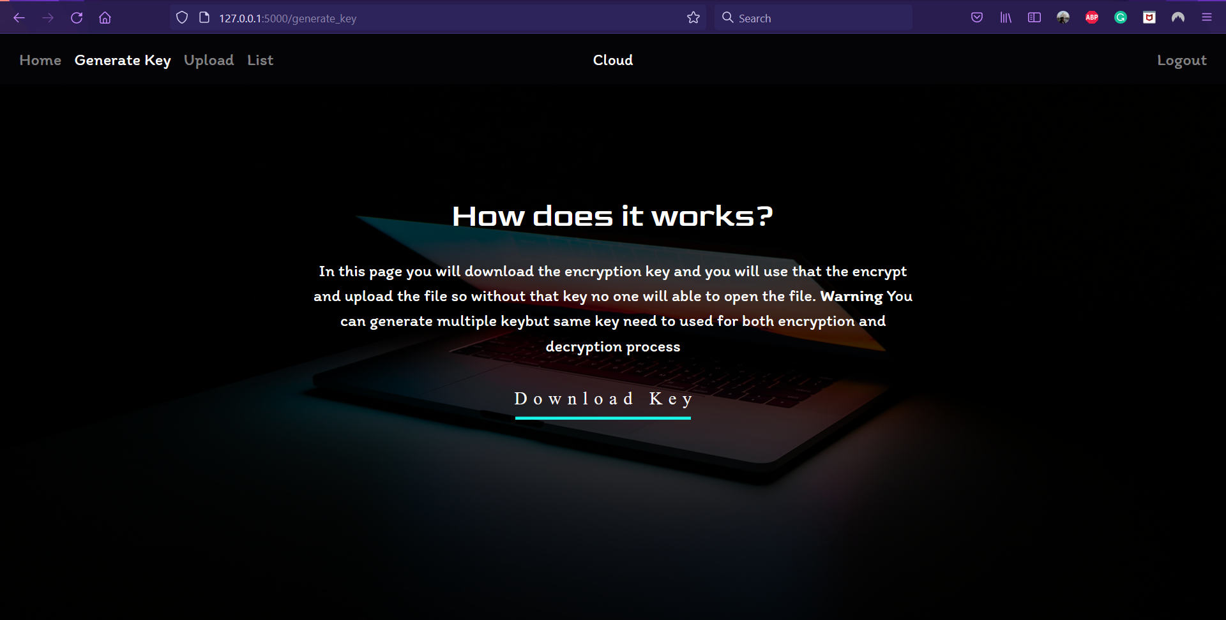

Slide 8
Design Phase | Completed
Development | Currently We Are In This Phase. Using Python & SQLite To Develop Our Product.
Validation | To-do
Testing | To-do
PROJECT STATUS REPORT:

